Slide 1
Hazard Communications
OSHA General Industry
Outreach Training

Slide 2
Introduction
Lesson objectives:
Identify the employer’s responsibilities under the HCS, including training requirements.
Identify components of a Hazard Communication program.
Describe requirements of the different types of Hazard Communication labels.
Locate pertinent information about chemicals on labels, including other forms of hazard communication, to ensure “right to understanding” provisions of GHS requirements.
Notes:
Terminal Objective:
Given current OSHA and general industry information regarding worksite illnesses, injuries, and/or fatalities, the student will be able to recognize responsibilities related to hazard communications, including GHS [Global Harmonizing System] requirements.
Enabling Objectives:
Identify the employer’s responsibilities under the Hazard Communication Standard [HCS], including training requirements.
Identify components of a Hazard Communication program.
Describe requirements of the different types of Hazard Communication labels.
Locate pertinent information about chemicals on labels, including other forms of hazard communication, to ensure “right to understanding” provisions of GHS requirements.

Slide 3
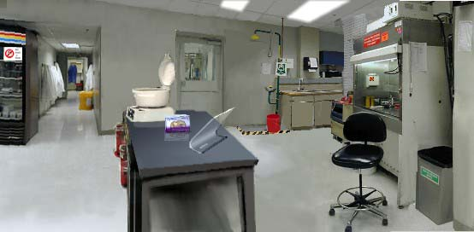
Introduction
Case study
Source: OSHA
Notes:
Source: OSHA Aligns Hazard Communication Standard with the United Nations’ Globally Harmonized System of Classification and Labeling of Chemicals (2012), OSHA QuickTakes vol. 11 issue 7, https://www.osha.gov/as/opa/quicktakes/qtGHS03212012.html#11
“The Right to Understand
Workers have sometimes had difficulty understanding information presented on safety data sheets (SDSs). In some cases the length and complexity of the documents have made it difficult for workers to locate important safety information. In one testimony, a hospital safety director described a situation in which a worker was unable to find critical information on an SDS in an emergency situation:
". . . two gallons of the chemical xylene spilled in the lab of my hospital. By the time an employee had noticed the spill, the ventilation had already sucked most of the vapors into the HVAC. This, in turn, became suspended in the ceiling tile over our radiology department. Twelve employees were sent to the emergency room. To make the matter worse, the lab employee was frantically searching through the binder in her area for [the SDS for] xylene. Once she found it, she had difficulty locating the spill response section. After notifying our engineering department, she began to clean up the spill with solid waste rags, known for spontaneous combustion, and placing the rags into a clear plastic bag for disposal. She did not know that xylene has a flash point of 75 degrees Fahrenheit. She then walked the bag down to our incinerator room and left it there, basically creating a live bomb. Twelve people were treated from this exposure. The lab employee was very upset and concerned about the safety of the affected employees and visitors, and hysterically kept stating that she could not find the necessary spill response information."
OSHA's harmonized standard ensures that workers have access not only to labels and safety data sheets, but also to information that is easier to find and understand through the use of standardized formats and label elements: signal words, pictograms, hazard statements, and precautionary statements.”

Slide 4
Introduction
HCS/GHS
Save lives
  Approximately 43 per year (deaths)
  Approximately 585 per year injuries/illnesses
Save $
  $475.2M in increased productivity
  $32.2M in cost savings
Notes:
Source: https://www.osha.gov/pls/oshaweb/owadisp.show_document?p_table=NEWS_RELEASES&p_id=22038
It is estimated that the revised Hazard Communication Standard can prevent 43 deaths and 585 injuries/illnesses per year, as well as save an estimated $475 million per year by improving the quality, consistency, and clarity of hazard information that workers receive.
Source: https://www.osha.gov/dsg/hazcom/index.html
Major changes to the Hazard Communication Standard
Hazard classification: Provides specific criteria for classification of health and physical hazards, as well as classification of mixtures.
Labels: Chemical manufacturers and importers will be required to provide a label that includes a harmonized signal word, pictogram, and hazard statement for each hazard class and category. Precautionary statements must also be provided.
Safety Data Sheets: Will now have a specified 16-section format.
Information and training: Employers are required to train workers by December 1, 2013 on the new labels elements and safety data sheets format to facilitate recognition and understanding.

Slide 5
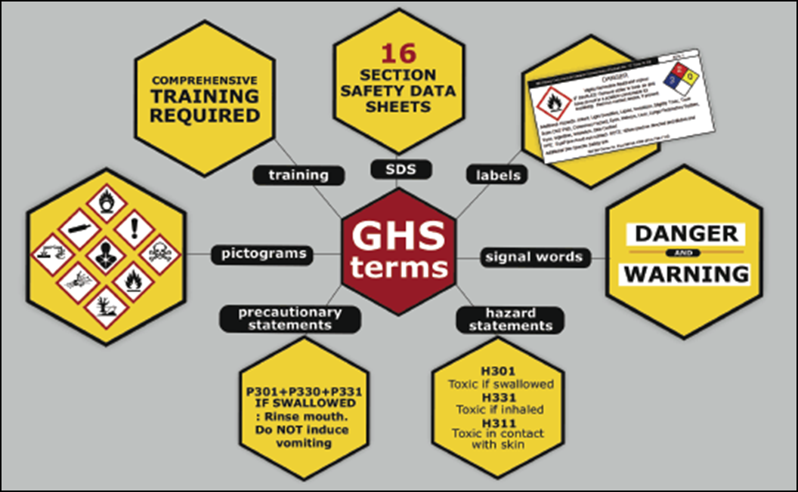
Introduction
Seven major elements in the GHS-aligned Hazard Communication Standard
Source: OSHA
Notes:
Seven Major Elements to Hazard Communication/GHS include:
SDS
Labels
Signal words
Hazard statements
Precautionary statements
Pictograms
Training

Slide 6
Employer Responsibilities
Employer responsibilities under the HCS:
Ensure labels are on incoming labels and not defaced
Maintain SDSs from shipments
Obtain SDSs if not received
  Send new SDS’s to TVC to upload in Verisk 3E
Ensure SDSs are readily accessible
  Paper Copies, Electronically
Ensure chemicals in workplace are properly labeled, tagged, or marked
Provide information and training to employees
Provide information/access for employees in multi-employer workplaces
Develop, implement, and maintain a written hazard communication program
Notes:
29 CFR 1910.1200
Employer responsibilities; employer shall:
Ensure that labels on incoming containers of hazardous chemicals are not removed or defaced
Maintain copies of SDS received with incoming shipments
Obtain SDS as soon as possible for chemicals received without an SDS if employee requests the SDS
Ensure that SDS are readily accessible during each work shift to employees when they are in their work area(s)
Ensure that each container of hazardous chemicals in the workplace is labeled, tagged, or marked properly
Ensure that employees are provided information and training to the extent necessary to protect them in the event of a spill or leak of a hazardous chemical from a sealed container
In multi-employer workplaces, ensure that employees of other employer(s) will have on-site access to SDSs for each hazardous chemical they may be exposed to while working, are informed of any precautionary measures needed to protect themselves under normal operating conditions or in foreseeable emergencies, and are informed of the labeling system used in the workplace
Develop, implement, and maintain a written hazard communication program

Slide 7
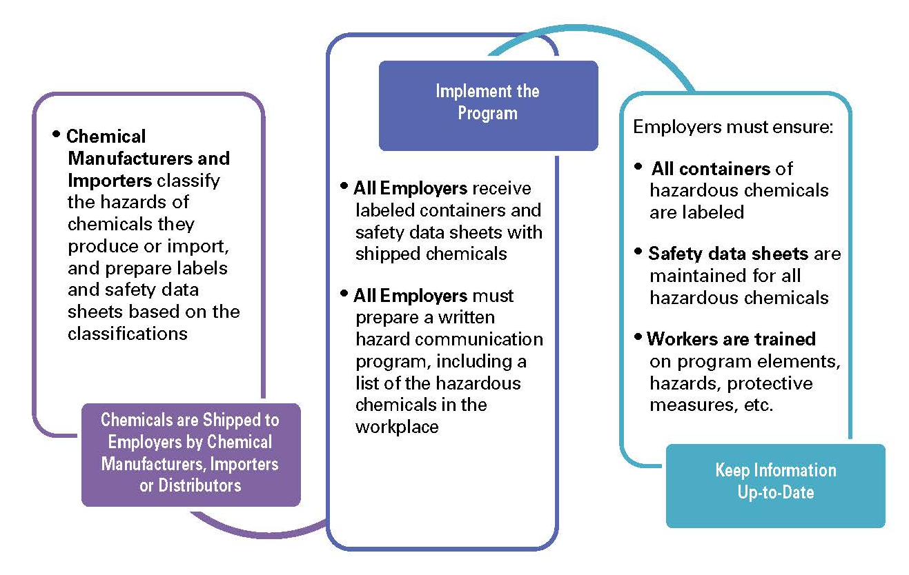
Employer Responsibilities
How hazard communication works:
Source: OSHA
Notes:
Source: Hazard Communication: Small Entity Compliance Guide for Employers That Use Hazardous Chemicals (2014), OSHA #3695-03, https://www.osha.gov/Publications/OSHA3695.pdf

Slide 8
Hazard Communication Program
Requirements for a written program:
Develop, implement, and maintain a written hazard communication program
Main intent is to ensure compliance with standard in a systematic way that coordinates all elements
Notes:
Source: Hazard Communication: Small Entity Compliance Guide for Employers That Use Hazardous Chemicals (2014), OSHA #3695-03, https://www.osha.gov/Publications/OSHA3695.pdf
“Paragraph (e), Written Hazard Communication Program, requires employers to prepare and implement a written hazard communication program. This does not need to be lengthy or complicated. The main intent of the requirement is to help ensure that compliance with the standard is done in a systematic way and that all elements are coordinated. Thus, the program must describe how the employer will address the requirements of paragraphs (f) Labels and Other Forms of Warning; (g) Safety Data Sheets; and (h) Employee Information and Training, in the workplace.”

Slide 9
Hazard Communication Program
Components of written program:
Lists of hazardous chemicals present at worksite
Availability of SDS’s to employees and downstream employers
Labeling of chemical containers
Training programs regarding hazards of chemicals and protective measures
Notes:
Written Program Requirements
Including lists of hazardous chemicals present
Availability of safety data sheets to employees and downstream employers;
Labeling of containers of chemicals in the workplace, as well as of containers of chemicals being shipped to other workplaces;
And development and implementation of employee training programs regarding hazards of chemicals and protective measures

Slide 10
Hazard Communication Program
List of hazardous chemicals:
Use product identifier
  Product name, common name or chemical name
  Same as name used on SDS and label
Inventory of chemicals
  employer must have available an SDS for each
Covers all chemicals in all forms, whether contained or not
Include chemicals in containers, pipes, and those generated by work operations
Notes:
Source: Hazard Communication: Small Entity Compliance Guide for Employers That Use Hazardous Chemicals (2014), OSHA #3695-03, https://www.osha.gov/Publications/OSHA3695.pdf
List of hazardous chemicals known to be present in the workplace:
List may be kept by product identifier from SDS; may be listed by product name, common name, or chemical name;
Important: name used must be the same as term used on SDS and label for cross-referencing.
“the HCS covers chemicals in all forms---liquids, solids, gases, vapors, fumes, and mists---whether they are “contained” or not. The nature of the chemical and the potential for exposure are the factors that determine whether a chemical is covered.” (pgs. 11-12)
“Identify chemicals in containers, including pipes, but also think about chemicals that are generated during work operations. For example, welding fumes, dusts, and exhaust fumes are all sources of chemical exposures.” (pg. 12)
For use in other program elements, as you survey workplace for hazardous chemicals, you may want to make note their locations and indicate hazards found on labels.

Slide 11
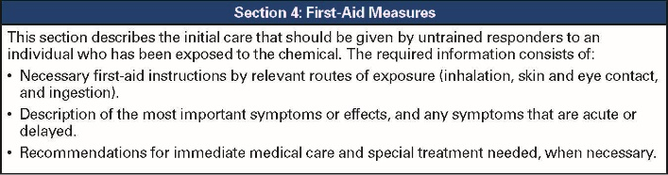
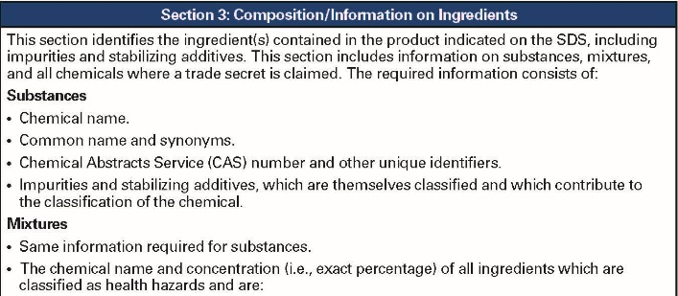
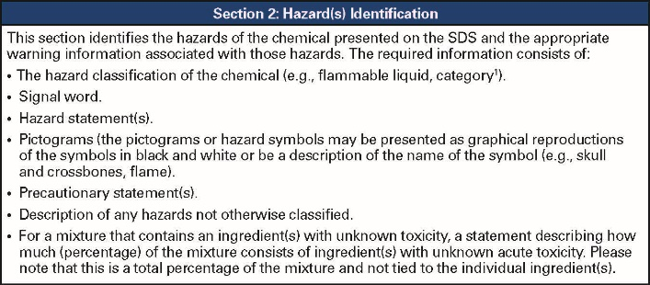
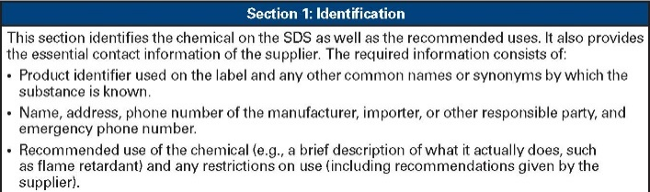
Hazard Communication Program
Safety Data Sheet (SDS):
Available and accessible to workers
Required for all hazardous chemicals
Do not use hazardous chemicals if there is no SDS available
16-section format
Source: OSHA
Notes:
Source: Hazard Communication Standard: Safety Data Sheets (2012), OSHA Brief DSG BR-3514, https://www.osha.gov/Publications/OSHA3514.html

Slide 12

Hazard Communication Program
SDS documentation:
Designate person(s) responsible for obtaining and maintaining SDS’s
Describe how SDS’s are
maintained and how
employees can access them
Procedures if SDS is not
received with first shipment
Must have SDS for each chemical; train workers on SDS format and use
Source: OSHA
Notes:
Source: Hazard Communication Standard: Safety Data Sheets (2012), OSHA Brief DSG BR-3514, https://www.osha.gov/Publications/OSHA3514.html
Written program should document:
Designated person(s) responsible for obtaining and maintaining SDSs
How SDSs are maintained in workplace (e.g., notebooks in the work area(s) or electronically); how workers obtain access to them when during the work shift
Procedures to follow when SDS is not received at time of the first shipment
SDS for each chemical in the workplace and training of workers that includes review of SDS format and use

Slide 13
Hazard Communication Program
SDS 16-section format:
Section 1: Identification
Section 2: Hazard(s) identification
Section 3: Composition/information on ingredients
Section 4: First-aid measures
Section 5: Fire-fighting measures
Section 6: Accidental release measures
Section 7: Handling and storage
Section 8: Exposure control/personal protection
Source: OSHA
Notes:
Source: Hazard Communication Standard: Safety Data Sheets (2012), OSHA Brief DSG BR-3514, https://www.osha.gov/Publications/OSHA3514.html
“Sections 1 through 8 contain general information about the chemical, identification, hazards, composition, safe handling practices, and emergency control measures (e.g., fire fighting). This information should be helpful to those that need to get the information quickly.”
Section 1: Identification – identifies the chemical on the SDS and its recommended uses; provides contact information of the supplier
Section 2: Hazard(s) Identification – identifies the hazards of the chemical and appropriate warning information
Section 3: Composition/Information on Ingredients – identifies ingredient(s) contained in product, including impurities and stabilizing additives; includes information on substances, mixtures, and all chemicals where a trade secret is claimed
Section 4: First-Aid Measures – describes initial care that should be given by untrained responders to an individual who has been exposed to the chemical
Section 5: Fire-Fighting Measures – provides recommendations for fighting a fire caused by the chemical
Section 6: Accidental Release Measures – provides recommendations on appropriate response to spills, leaks, or releases, including containment and cleanup to prevent or minimize exposure to people, properties, or the environment
Section 7: Handling and Storage – provides guidance on safe handling practices and conditions for safe storage of chemicals
Section 8: Exposure Controls/Personal Protection – indicates exposure limits, engineering controls, and PPE measures that can be used to minimize worker exposure

Slide 14
Hazard Communication Program
Section 9: Physical and chemical properties
Section 10: Stability and reactivity
Section 11: Toxicological information
Section 12: Ecological information
Section 13: Disposal considerations
Section 14: Transport information
Section 15: Regulatory information
Section 16: Other information
Not regulated by OSHA
Notes:
Source: Hazard Communication Standard: Safety Data Sheets (2012), OSHA Brief DSG BR-3514, https://www.osha.gov/Publications/OSHA3514.html
“Sections 9 through 11 and 16 contain other technical and scientific information, such as physical and chemical properties, stability and reactivity information, toxicological information, exposure control information, and other information including the date of preparation or last revision.”
Sections 12, 13, 14, & 15 are regulated by other agencies (i.e. EPA, DOT).
Section 9: Physical and Chemical Properties – identifies physical and chemical properties associated with the substance or mixture
Section 10: Stability and Reactivity – describes reactivity hazards of chemical and chemical stability information; broken into three parts: reactivity, chemical stability, and other
Section 11: Toxicological Information – identifies toxicological and health effects information or indicates that such data is not available
Section 12: Ecological Information – provides information to evaluate the environmental impact of the chemical(s) if it were released into the environment
Section 13: Disposable Considerations – provides guidance on proper disposal practices, recycling, or reclamation of the chemical(s) or its container, and safe handling practices
Section 14: Transport Information – provides guidance on classification information for shipping and transporting of hazardous chemical(s) by road, air, rail, or sea
Section 15: Regulatory Information – identifies safety, health, and environmental regulations specific for the product that is not indicated anywhere else on SDS
Section 16: Other Information – indicates when SDS was prepared/revised; may state where changes have been made to previous versions; other useful information

Slide 15
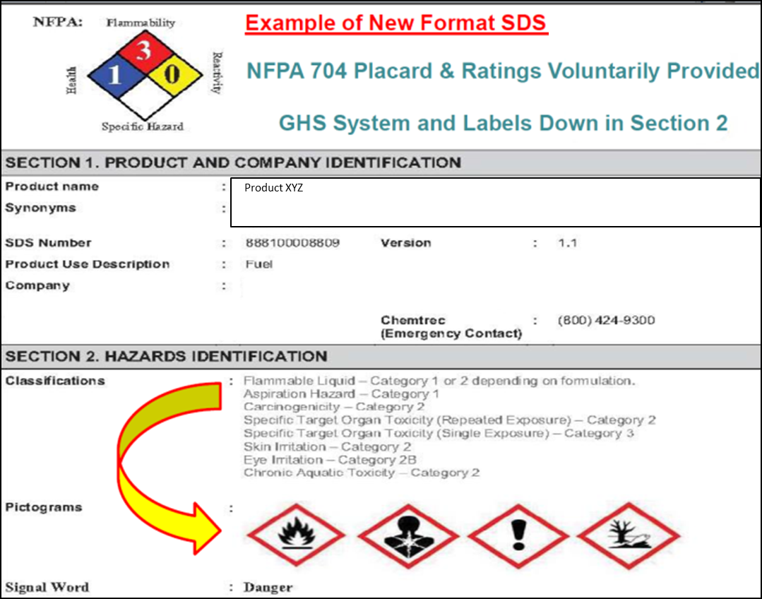
Hazard Communication Program
Source: OSHA

Slide 16
Hazard Communication Program
Labeling:
All containers of hazardous materials must be labeled
Immediate warning
Snapshot of hazards and protective information
Notes:
Source: Hazard Communication Standard: Labels and Pictograms (2013), OSHA Brief DSG BR-3636, https://www.osha.gov/Publications/OSHA3636.pdf
“…Information about chemical hazards [is to] be conveyed on labels using quick visual notations to alert the user, providing immediate recognition of the hazards. Labels must also provide instructions on how to handle the chemical so that chemical users are informed about how to protect themselves.
The label provides information to the workers on the specific hazardous chemical. While labels provide important information for anyone who handles, uses, stores, and transports hazardous chemicals, they are limited by design in the amount of information they can provide. Safety Data Sheets (SDSs), which must accompany hazardous chemicals, are the more complete resource for details regarding hazardous chemicals.”

Slide 17
Hazard Communication Program
Documentation for labeling:
Designate person(s) responsible for labeling compliance
Describe alternatives to labeling of stationary process containers
Ensure all workplace containers are labeled appropriately
Labels included in training (shipping and workplace containers)
Procedures for reviewing/updating workplace label information
Notes:
Source: Hazard Communication: Small Entity Compliance Guide for Employers That Use Hazardous Chemicals (2014), OSHA #3695-03, https://www.osha.gov/Publications/OSHA3695.pdf
Written Hazard Communication Program should document:
Designated person(s) responsible for ensuring compliant labeling of shipped and in-plant containers
Description of written alternatives to labeling of stationary process containers (if used)
Appropriate labels on all workplace containers, including those received from a supplier, secondary containers, and stationary process containers
Description and explanation of labels on both shipped and workplace containers included in the employee training program
Procedures to review and update workplace label information when necessary

Slide 18
Hazard Communication Program
Required elements for shipping labels:
Name, address, telephone number
Product identifier
Signal word
Hazard statement(s)
Precautionary
statement(s)
Pictogram
This sample illustrates the required elements for shipping labels. Source: OSHA
Notes:
Environmental hazards are regulated by the Environmental Protection Agency (EPA) not OSHA.

Slide 19
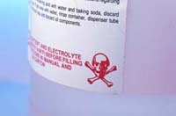
Hazard Communication Program
Requirements for workplace labels:
Employers can create own labeling system that works for their workplace/employees
Can choose same label required for shipped containers or alternative labels as long as they provide general information about hazards
Train employees to understand
Source: OSHA
Notes:
Employers may choose to label workplace containers either with the same label required for shipped containers of the chemical, or may instead use alternative labels, as long as those labels provide employees with general information about the hazards of the chemical, and the employer provides training so that employees exposed to the chemical understand the specific hazards it presents.

Slide 20
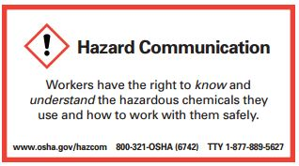
Hazard Communication Program
Training requirements:
Train employees on
hazardous chemicals
in their work area
  Before initial assignment
  When new hazards are introduced
  Non-routine tasks
Include in training
  Methods/observations to determine presence/release of chemical in work area
  Hazards of chemicals
  Appropriate protective measures
  Where and how to obtain additional information
Source: OSHA
Notes:
Source: Hazard Communication: Small Entity Compliance Guide for Employers That Use Hazardous Chemicals (2014), OSHA #3695-03, https://www.osha.gov/Publications/OSHA3695.pdf
“For information and training to be effective, the workers in the training must comprehend the hazards in the workplace and ways to protect themselves. OSHA does not expect that workers will be able to recall and recite all data provided about each hazardous chemical in the workplace. What is most important is that workers understand that they are exposed to hazardous chemicals, know how to read labels and SDSs, and have a general understanding of what information is provided in these documents, and how to access these tools. Workers must also be aware of the protective measures available in their workplace, how to use or implement these measures, and who they should contact if an issue arises.” (pg. 25)
Training… must address the following:
Methods and observations used to determine presence or release of chemical in work area, such as:
1. Monitoring – conducted by employer; continuous monitoring devices
2. Visual appearance or odor of hazardous chemical when being released
Hazards of chemicals in the work area, including:
1. Physical hazards
2. Health hazards
3. Simple asphyxiation
4. Combustible dust
5. Pyrophoric gas
6. Other hazards not otherwise classified
Measures employees can take to protect themselves from hazards, including
1. Specific procedures employer has implemented to protect employees from exposure to hazardous chemicals
2. Examples – Appropriate work practices, emergency procedures, PPE to be used
Details of hazard communication program developed by employer
1. Explanation of labels received on shipped containers and the workplace labeling system used by the employer
2. SDS, including format (where each type of information is located)
3. How employees can obtain and use the appropriate hazard information
(pg. 25-26)

Slide 21

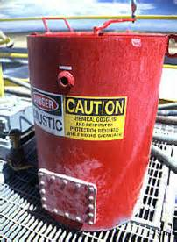


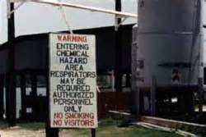
Hazard Communication Labels
Types of labels:
HCS shipping labels
HCS workplace labels
NFPA 704 labels
HMIS labels
DOT shipping labels, placarding, and markings
Source of graphics: OSHA
Notes:
There are several types of labels that might be found on hazardous chemicals in a workplace, including:
Hazard Communication Standard (HCS) shipping labels
Hazard Communication Standard (HCS) workplace labels
National Fire Protection Association 704 labels
Hazardous Materials Information Systems
Department of Transportation shipping labels, placarding, and marking

Slide 22
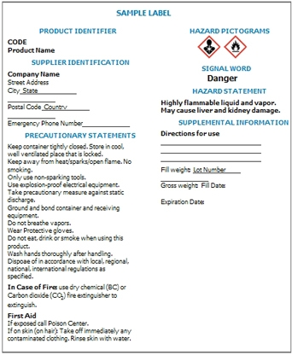
Hazard Communication Labels
Required elements for HCS shipping labels:
Product identifier
Signal word
Hazard statement(s)
Precautionary statement(s)
Pictogram
Name, address, telephone number
Source: OSHA
Notes:
Source: Hazard Communication: Small Entity Compliance Guide for Employers That Use Hazardous Chemicals (2014), OSHA #3695-03, https://www.osha.gov/Publications/OSHA3695.pdf
According to the HCS, the term, label, is defined as “an appropriate group of written, printed or graphic information elements concerning a hazardous chemical that is affixed to, printed on, or attached to the immediate container of a hazardous chemical, or to the outside packaging” (pg. 2).
“To increase uniformity of labels, the HCS requires “the following information, located together (other information may also appear on the label):
Product identifier
Signal word
Hazard statement(s)
Precautionary statement(s)
Pictogram
Name, address, telephone number of the responsible party [manufacturer, importer, or distributor]”
(pg. 14)

Slide 23
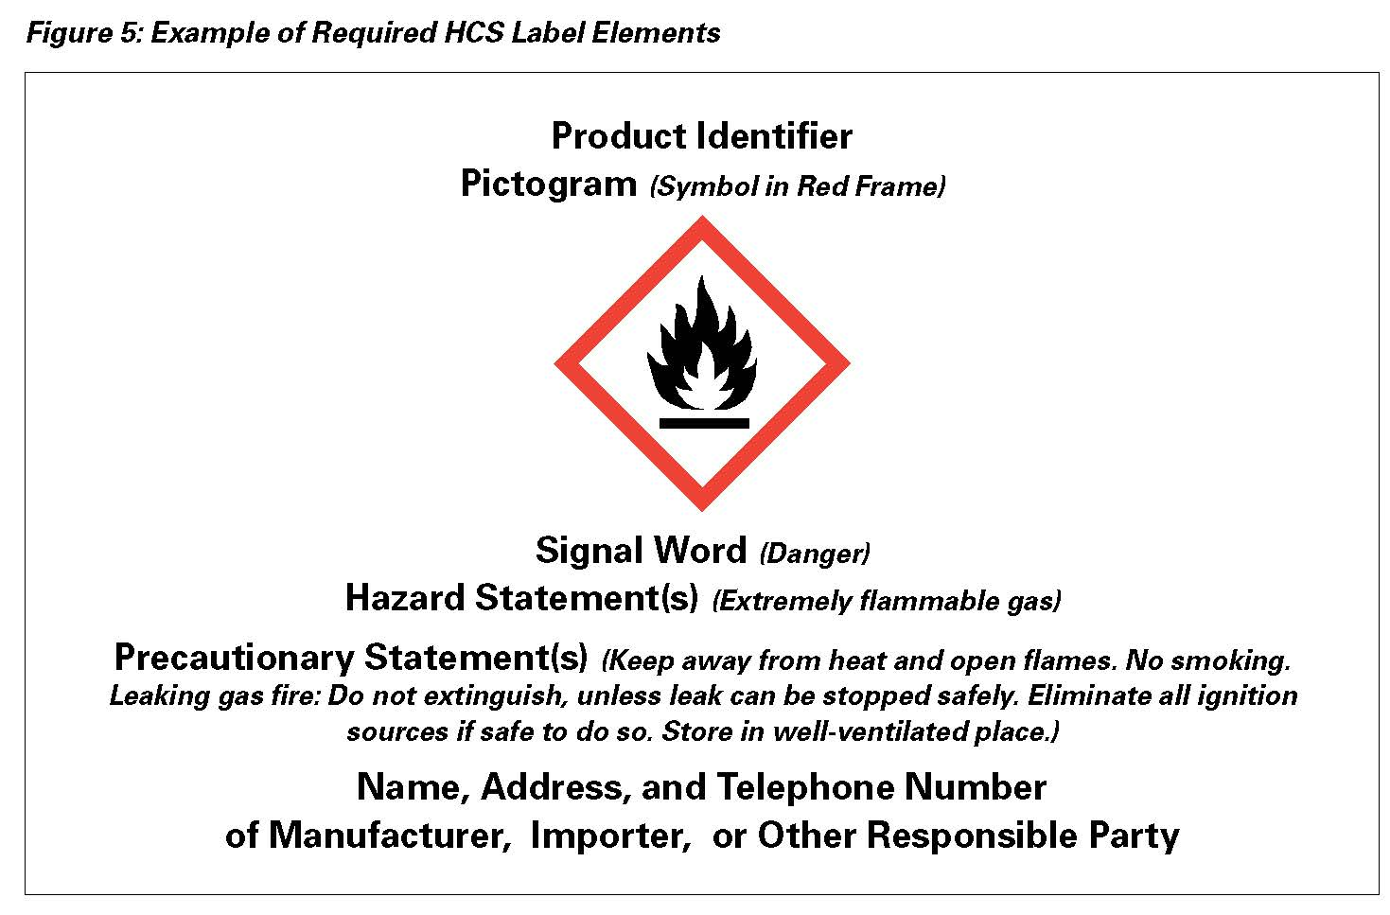
Hazard Communication Labels
How the hazardous chemical is identified
Contact information of Responsible Party
Source: OSHA
Notes:
(Note: click to move through animation on slide)
Source: Source: Hazard Communication: Small Entity Compliance Guide for Employers That Use Hazardous Chemicals (2014), OSHA #3695-03, https://www.osha.gov/Publications/OSHA3695.pdf
“Those who know the most about the chemicals – the companies that produce, import, or distribute them – have the responsibility to assess available information, and convey what is needed to downstream employers where the hazardous chemicals are used.” The name, address, and telephone number of the responsible party must be included on the label.
“The product identifier is any chemical, common, or trade name or designation that the chemical manufacturer or importer chooses to use on the label. The term must also appear on the SDS.” (pg. 14)

Slide 24
Hazard Communication Labels
Indicates the relative level of severity of hazard;
“Danger” is used for more severe hazards and “Warning” for less severe hazards
Pictograms convey specific information about the hazards of a chemical in symbols and other graphic elements
Source: OSHA
Notes:
(Note: click to move through animation on slide)
Source: Source: Hazard Communication: Small Entity Compliance Guide for Employers That Use Hazardous Chemicals (2014), OSHA #3695-03, https://www.osha.gov/Publications/OSHA3695.pdf
“A signal word is a word used to indicate the relative level of severity of hazard and alert the reader to a potential hazard on the label. The signal words used in the standard are “danger” and “warning.” “Danger” is used for the more severe hazards, while “warning” is used for the less severe hazards.” (pg. 14) If there are multiple hazards, the word that indicates the highest severity level is used.
“A pictogram is a composition that may include a symbol plus other graphic elements, such as a border, background pattern, or color, that is intended to convey specific information about the hazards of a chemical. Eight pictograms are designated under this standard for application to a hazard category. Under HazCom 2012, pictograms are black symbols, on a white background, with a red diamond border. “ (pg. 15)

Slide 25
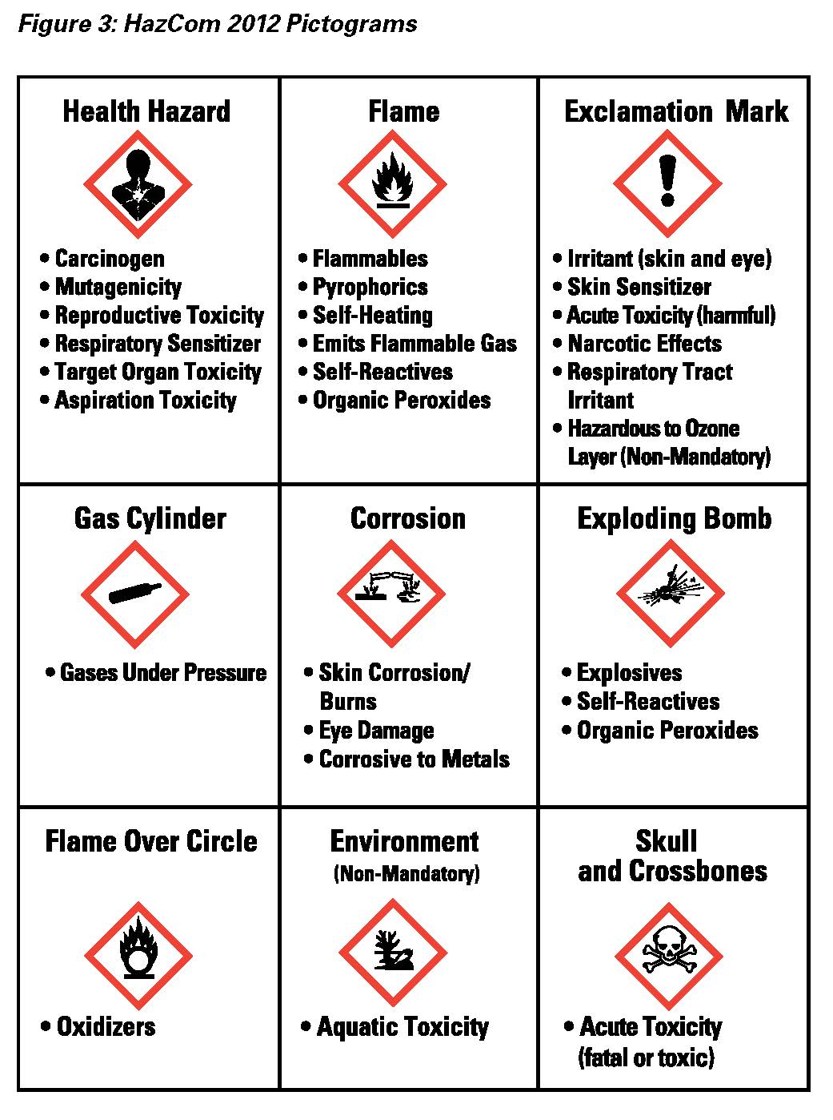



Hazard Communication Labels
Health Hazard
Flame
Exclamation Mark
Source: OSHA
Notes:
Source: Source: Hazard Communication: Small Entity Compliance Guide for Employers That Use Hazardous Chemicals (2014), OSHA #3695-03, https://www.osha.gov/Publications/OSHA3695.pdf
“Pictograms are an important addition to the hazard communication tools in the standard. A pictogram draws the attention of a label reader, and you and your workers should be aware that the appearance of a pictogram in a red diamond frame means that a hazard of concern is present in the product. Some of the pictograms in the standard have symbols that resemble the hazardous effect, and others are merely meant to attract attention. Pictograms may be used for several different hazardous effects as well.” (pg. 15)
Source: Source: Hazard Communication Standard Pictogram (2012), OSHA QuickCard 3491-02, https://www.osha.gov/Publications/HazComm_QuickCard_Pictogram.html
Pictograms include:
Health hazards – carcinogen, mutagenicity, reproductive toxicity, respiratory sensitizer, target organ toxicity, aspiration toxicity
Flame – flammables, pyrophorics, self-heating, emits flammable gas, self-reactives, organic peroxides
Exclamation mark – irritant (skin and eye), skin sensitizer, acute toxicity (harmful), narcotic effects, respiratory tract irritant, hazardous to ozone layer (non-mandatory)

Slide 26



Hazard Communication Labels
Gas Cylinder
Corrosion
Exploding Bomb
Source: OSHA
Notes:
Source: Source: Hazard Communication Standard Pictogram (2012), OSHA QuickCard 3491-02, https://www.osha.gov/Publications/HazComm_QuickCard_Pictogram.html
Pictograms include:
Gas cylinder – gases under pressure
Corrosion – skin corrosion/burns, eye damage, corrosive to metals
Exploding bomb – explosives, self-reactives, organic peroxides

Slide 27



Hazard Communication Labels
Skull and Crossbones
Environmental
(Non-Mandatory)
Flame Over Circle
Not regulated by OSHA
Source: OSHA
Notes:
Source: Source: Hazard Communication Standard Pictogram (2012), OSHA QuickCard 3491-02, https://www.osha.gov/Publications/HazComm_QuickCard_Pictogram.html
Pictograms include:
Flame over circle – oxidizers
Environmental (non-mandoatory) – aquatic toxicity
Skull and crossbones – acute toxicity (fatal or toxic)
Source: Source: Hazard Communication: Small Entity Compliance Guide for Employers That Use Hazardous Chemicals (2014), OSHA #3695-03, https://www.osha.gov/Publications/OSHA3695.pdf
“One of the systems that has long used pictograms is the international transport system. This system has been adopted by the U.S. Department of Transportation (DOT), and is familiar to those who handle shipping containers in the United States. The symbols have been harmonized as much as possible for the hazards covered both in transport and in the workplace. While both pictograms are diamond-shaped, the transport system’s pictograms have backgrounds of various colors. Where the shipping container is also the container used in the workplace, workers must be made aware of the DOT pictograms¹, as they may appear on the label in addition to, or instead of, the HazCom 2012 pictograms used to represent the same hazard…. Note that the environment pictogram located in the center of the bottom row… is not required under the OSHA standard since OSHA does not regulate environmental hazards. However, you may see this pictogram used on labels and SDSs to convey environmental hazards, and that will provide useful information for you to use in managing your chemicals.” (pg. 15)

Slide 28
Hazard Communication Labels
Describes recommended measures that should be taken to minimize or prevent adverse effects resulting from exposure to a hazardous chemical, or improper storage or handling.
Statement assigned to hazard class and category that describes the nature of the hazard(s), of a chemical, including, where appropriate, the degree of hazard.
Source: OSHA
Notes:
Source: Source: Hazard Communication: Small Entity Compliance Guide for Employers That Use Hazardous Chemicals (2014), OSHA #3695-03, https://www.osha.gov/Publications/OSHA3695.pdf
“A hazard statement is a statement assigned to a hazard class and category that describes the nature of the hazard(s) of a chemical, including, where appropriate, the degree of hazard. Example: Fatal if swallowed. The hazard statement(s) for a hazardous chemical describe the hazard(s) in text, in a simple, direct manner. There is a hazard statement for each hazard category of a hazard class, and it will vary depending on the degree of hazard. The example… [Fatal if swallowed] is a hazard statement for acute oral toxicity. The hazard statement conveys that the chemical is severely toxic, and ingestion of the chemical results in death. But for less toxic chemicals, the hazard statement may be “toxic if swallowed” or “harmful if swallowed.” As with the signal words, this information conveys the relative severity of the hazard, which impacts how it is handled and controlled.” (pgs. 14-15)
“A precautionary statement is a phrase that describes recommended measures that should be taken to minimize or prevent adverse effects resulting from exposure to a hazardous chemical, or improper storage or handling. Example: Do not eat, drink, or smoke when using this product.
Precautionary statements are key to helping you decide what you need to do to protect workers and your workplace. There are four types of statements: Prevention, Response, Storage, and Disposal. These have been assigned to hazard classes and categories.” (pg. 18)

Slide 29
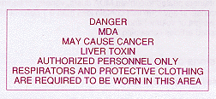
Hazard Communication Program
Requirements for workplace labels:
Same information as label from manufacturer or product identifier and words, pictures, symbols or combination thereof
May include signs, placards, process sheets, batch tickets, operation procedures, other written materials
Source of graphics: OSHA
Notes:
Source: Modification of the Hazard Communication Standard (HCS) to conform with the United Nations’ (UN) Globally Harmonized System of Classification and Labeling of Chemicals (GHS): Questions and Answers, (n.d.), OSHA online, https://www.osha.gov/dsg/hazcom/hazcom-faq.html
“For the workplace label, the container must be labeled, tagged, or marked with either the:
Product identifier, signal word, pictogram(s), hazard statement(s), and precautionary statement(s) of the hazardous chemical; OR
Product identifier and words, pictures, symbols, or a combination of these that provide at least general information about the hazards of the chemicals, and which, in conjunction with the other information immediately available, provides employees with the specific information about the physical and health hazards of the hazardous chemical.
The employer may use signs, placards, process sheets, batch tickets, operating procedures, or other such written materials in lieu of affixing labels to individual stationary process containers, as long as the alternative method identifies the containers to which it is applicable and conveys the information required by 29 CFR 1910.1200 (f)(6), outlined above, to be on a label. The employer must ensure the written materials are readily accessible to the employees in their work area throughout each work shift.”

Slide 30
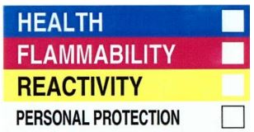
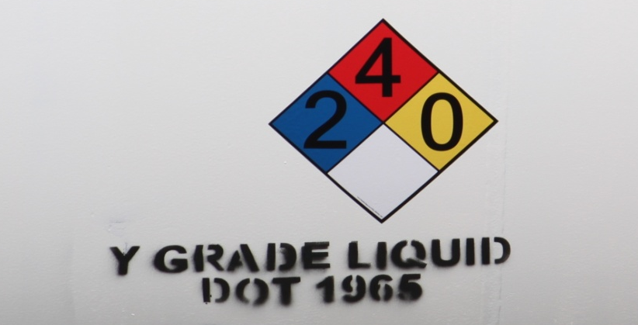
Hazard Communication Labels
Alternative workplace labels:
  Permitted for workplace labels
  Must provide at least general information regarding hazards of chemicals
  Hazard warnings or pictograms that conflict with HCS label elements cannot be used
  Examples: NFPA 704 and HMIS
Source: OSHA
Source: TEEX

Slide 31
Hazard Communication Labels
Other labels:
NFPA 704
  Overall diamond shape made up of four smaller diamonds
  Each smaller diamond is a different color
  Numbers within smaller diamonds represent severity of hazard
Source: OTIEC
Notes:
Source: http://www.nfpa.org/Assets/files/AboutTheCodes/704/704_FAQs.pdf
The NFPA Diamond is typically located outside buildings, on doors, or on tanks and is intended to provide visible information about hazards to emergency responders during incident such as a spill or fire.
The “square-on-point” or diamond shape of the overall symbol identifies the hazards of the material and the severity of the hazards in an arrangement of smaller, color-coded diamonds (representing the hazards), each of which has a numerical rating system (representing the severity of the hazard).
It is important to understand that the numbers used in the NFPA rating system are not relative ratings to the OSHA classification numbers and, in fact, are inverse. The NFPA rating system ranges from 0 to 4, with 0 being the least hazardous and 4 being the most hazardous; whereas, OSHA’s classification system ranges from 1 to 4, with 1 being the most severe hazard and 4 being the least severe hazard.
Source: https://www.osha.gov/Publications/OSHA3678.pdf

Slide 32
Hazard Communication Labels
  NFPA 704 – hazards and severity ratings
White = Other Special Hazards
W= reactivity to water
OX = oxidizer
SA = simple asphyxiant
Flammability Hazard
Blue = Health Hazards
0= normal material that
poses no health
1 = slight hazard
2 = moderate hazard
3 = extreme hazard
4 = deadly hazard
Yellow = Instability Hazards
0= normally stable
1 = slight hazard
2 = moderate hazard
3 = extreme hazard
4 = deadly hazard
Red = Flammability Hazards
0= will not burn
1 = flashpoint above 200°F
2 = flashpoint between
100 – 200°F
3 = flashpoint below 100°F
4 = flashpoint less than 73°F
Health Hazard
Instability Hazard
Other Special Hazard
Source: OTIEC
Notes:
Source: Comparison of NFPA 704 and HazCom 2012 Labels (2013), OSHA QuickCard 3678-08, https://www.osha.gov/Publications/OSHA3678.pdf

Slide 33
Hazard Communication Labels
Source: OSHA
Notes:
Example:
2 = Moderate health hazard
4 = Highly flammable, flashpoint less than 73°F
0 = Normally stable
W = reactive to water; do not use water

Slide 34
Hazard Communication Labels
HMIS label
  Intended for “In-plant” (workplace) labeling compliance
  Color-coded bars
  Numerical scale, 0-4,
  with 0 as lowest
  hazard and 4 as
  highest hazard
    0 = minimal hazard
    1 = slight hazard
    2 = moderate hazard
    3 = serious hazard
    4 = severe hazard
(Product identifier)
HEALTH
FLAMMABILITY
PHYSICAL HAZARD
PERSONAL PROTECTION
Source: OTIEC
Notes:
Source: HMIS or HMIG (Hazardous Materials Identification System), n.d., https://www.uwosh.edu/ehs/campus-health-and-safety/lab-shop-and-studio-safety/chemical-safety/hazard-communication-1/022bHazardComLabelingHMIS1.pdf
The Hazardous Materials Information System was developed by the American Coatings Association to support “In-Plant Labeling” compliance with the Hazardous Communication Standard.
The top space is used to identify the produce and the four color-coded bars indicate different hazards. A rating scale of 0 to 4 indicates the severity of the hazards, with 0 being a minimal hazard and 4 being a severe hazard. Letter codes or icons indicate what personal protective equipment should be used.

Slide 35
Hazard Communication Labels
HMIS hazard indicators
PPE Index:
A = safety glasses
B = safety glasses + gloves
C = safety glasses + gloves + apron
D = face shield + gloves + apron
E = safety glasses + gloves + dust
respirator
F = safety glasses + gloves + apron
+ dust respirator
G = safety glasses + gloves + vapor
respirator
H = splash goggles + gloves + apron
+ vapor respirator
I = safety glasses + gloves + dust
and vapor respirator
J = splash goggles + gloves + apron
+ dust and vapor respirator
K = air-line hood or mask + gloves +
full suit + boots
X = ask supervisor or safety specialist
Flammability ratings:
0 = will not burn
1 = flashpoint >200°F
2 = flashpoint ≥100°F,
but <200°F
3 = flashpoint <73°F and
boiling point >100°F,
or flashpoint between
73°F and 100°F
4 = flashpoint <73°F and
boiling point <100°F
(Product identifier)
Health ratings:
The second space signifies chronic health hazard with an asterisk (*)
Health ratings:
0 = no significant risk
1 = irritation/minor injury
2 = temporary/minor injury
3 = major injury
4 = life-threatening
HEALTH
Physical Hazard ratings:
0 = normally stable
1 = normally stable, but
can become unstable
2 = unstable
3 = explosive
4 = readily explosive
FLAMMABILITY
PHYSICAL HAZARD
PERSONAL PROTECTION
Source: OTIEC
Notes:
Source: HMIS or HMIG (Hazardous Materials Identification System), n.d., https://www.uwosh.edu/ehs/campus-health-and-safety/lab-shop-and-studio-safety/chemical-safety/hazard-communication-1/022bHazardComLabelingHMIS1.pdf
Blue bar indicates health hazards
0 = no significant risk
1 = possible irritation or minor injury (reversible condition)
2 = temporary or minor injury may occur
3 = major injury likely without prompt action/medical treatment
4 = life-threatening, major, or permanent damage may result due to single exposure or repeated exposures
Note: there are two spaces in the health bar; the second space is used to signify chronic health hazards, which is indicated by the presence of an asterisk (*), and warns of health problems due to long-term exposure.
Red indicates flammability hazards
0 = will not burn
1 = liquids, solids, and semi-solids that can ignite if preheated: flashpoint above 200°F
2 = ignition can occur if material is moderately heated or exposed to high ambient temperatures: flashpoint at or above 100°F but below 200°F
3 = ignition can occur under most normal temperatures: flammable liquids with flashpoint below 73°F and boiling points above 100°F, and liquids with
flashpoints between 73°F and 100°F
4 = ignition can spontaneously occur with air: flammable gases or very volatile flammable liquids with flashpoints below 73°F and boiling points below
100°F
Orange indicates physical hazards (hazard classes include Water Reactive, Organic Peroxides, Explosives, Compressed gases, Pyrophoric material, Oxidizers, and Unstable Reactive)
0 = non-explosive; normally stable (even under fire); will not react with water, polymerize, decompose, condense, or self-react
1 = normally stable, but can become unstable with high temperatures and pressures; may react non-violently with water; hazardous polymerization may
occur in the absence of inhibitors
2 = unstable materials; under normal temperatures and pressures, violent chemical changes may occur and there is a low risk for explosion; violent
reactions may occur with water; peroxides may form when exposed to air
3 = explosive mixtures may form with water that can detonate or have explosive reaction with strong initiating source; under normal temperatures and
pressures, polymerization, decomposition, self-reaction, or other chemical changes may occur with a moderate risk of explosion
4 = at normal temperature and pressure can have readily explosive water reaction, detonation or explosive decomposition, polymerization, or self-
reaction
White indicates personal protective equipment requirements for safe handling – letter codes and icons correspond to required PPE
A = safety glasses
B = safety glasses and gloves
C = safety glasses, gloves, and apron
D = face shield, gloves, and apron
E = safety glasses, gloves, and dust respirator
F = safety glasses, gloves, apron, and dust respirator
G = safety glasses, gloves, and vapor respirator
H = splash goggles, gloves, apron, and vapor respirator
I = safety glasses, gloves, dust and vapor respirator
J = splash goggles, gloves, apron, dust and vapor respirator
K = air-line hood or mask, gloves, full suit, and boots
X = ask supervisor or safety specialist about special handling requirements

Slide 36
Hazard Communication Labels
Ammonium Hydroxide
HEALTH
*
2
FLAMMABILITY
0
PHYSICAL HAZARD
0
PERSONAL PROTECTION
J
Source: OTIEC
Notes:
Example:
Product is “ammonium hydroxide”
Health hazard
* = chronic hazard
2 = moderate hazard that may cause temporary or minor injury
Flammability – minimal hazard; material will not burn
Physical Hazard – minimal hazard; normally stable material
Personal Protection – PPE needed includes splash goggles, gloves, apron, and dust/vapor respirator

Slide 37
Hazard Communication Labels
DOT shipping containers – marking, labeling, and placarding
  Uses graphic elements on square-on-point placards or labels to identify shipments of hazardous materials
  Square-on-points have backgrounds of various colors
  Where shipping container is also container used in workplace, workers must be made aware of DOT pictograms
  DOT Classification – groups hazardous materials based on dangers posed in transportation; 9 classes
Notes:
Source: Hazard Communication: Small Entity Compliance Guide for Employers That Use Hazardous Chemicals (2014), OSHA #3695-03, https://www.osha.gov/Publications/OSHA3695.pdf
“One of the systems that has long used pictograms is the international transport system. This system has been adopted by the U.S. Department of Transportation (DOT), and is familiar to those who handle shipping containers in the United States. The symbols have been harmonized as much as possible for the hazards covered both in transport and in the workplace. While both pictograms are diamond-shaped, the transport system’s pictograms have backgrounds of various colors. Where the shipping container is also the container used in the workplace, workers must be made aware of the DOT pictograms¹, as they may appear on the label in addition to, or instead of, the HazCom 2012 pictograms used to represent the same hazard.” (pg. 15)
Source: https://www.fmcsa.dot.gov/regulations/hazardous-materials/how-comply-federal-hazardous-materials-regulations
Class 1 Explosives
Class 2 Gases
Class 3 Flammable Liquid
Class 4 Flammable Solid
Class 5 Oxidizing Substance; Organic Peroxides
Class 6 Poisonous (Toxic) and Infectious Substances
Class 7 Radioactive Material
Class 8 Corrosives
Class 9 Miscellaneous Dangerous Goods (includes Environmentally Hazardous Substances, Elevated Temperature Material, Hazardous Wastes, and Marine Pollutants)

Slide 38
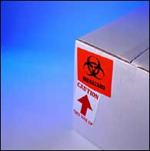
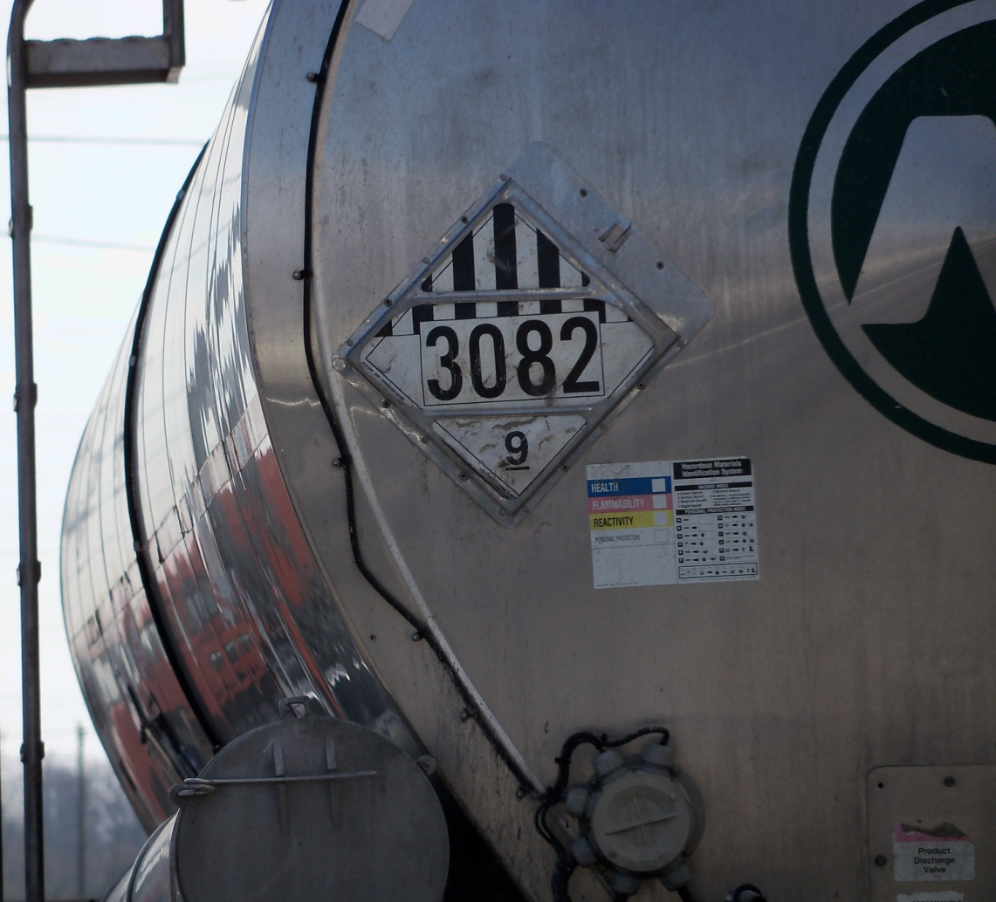

Hazard Communication Labels
  Labels
  Placards
  Markings
Source: OSHA
Source: TEEX
Source: DOT - PHMSA
Notes:
Source: Hazard Communication: Small Entity Compliance Guide for Employers That Use Hazardous Chemicals (2014), OSHA #3695-03, https://www.osha.gov/Publications/OSHA3695.pdf
“The U.S. Department of Transportation (DOT) uses the terms transport “placards” or “labels” to refer to the diamond-shaped (square-on-point) graphic elements that are used to identify shipments of hazardous materials.” (pg. 15)

Slide 39
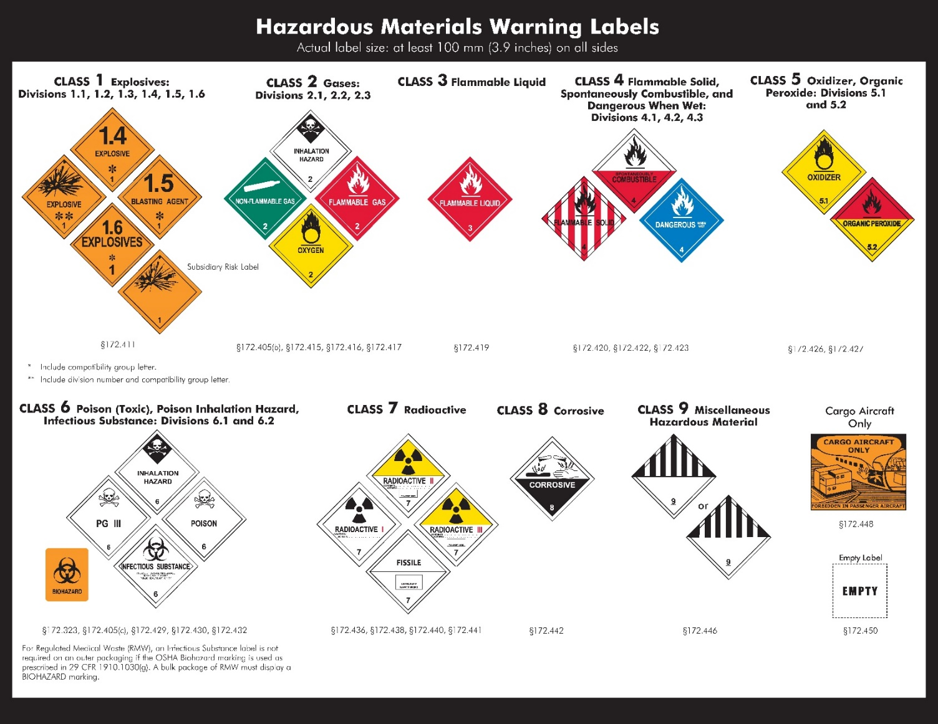
Hazard Communication Labels
DOT
Warning
Labels
Source: DOT - PHMSA
Notes:
Source: DOT Chart 15, Hazardous Materials Markings, Labeling and Placarding Guide (n.d.), U.S. Department of Transportation, Pipeline and Hazardous Materials Safety Administration, PHH50-0138-0413, https://www.fmcsa.dot.gov/sites/fmcsa.dot.gov/files/docs/Hazardous_Materials_Markings_Labeling_and_Placarding_Guide_508CLN.pdf
49 CFR 172 Subpart E
§172.400 General labeling requirements.
Source: How to Comply with Federal Hazardous Materials Regulations (n.d., Federal Motor Carrier Safety Administration. https://www.fmcsa.dot.gov/regulations/hazardous-materials/how-comply-federal-hazardous-materials-regulations
“General labeling requirements are contained in 49 CFR subpart E Part 172. Each person who offers for transportation or transports a hazardous material shall ensure the package is properly labeled. There are a number of exceptions to the labeling requirements contained in 172.400a. Prohibited labeling is contained in 172.401.”

Slide 40
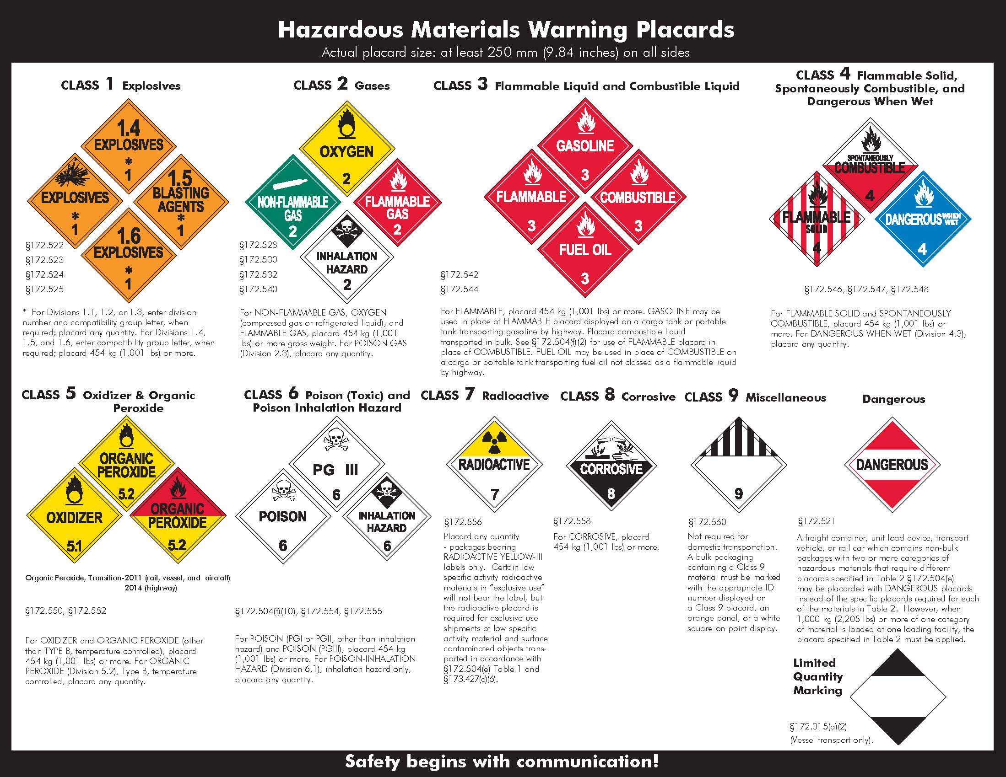
Hazard Communication Labels
DOT
Warning
Placards
Source: DOT - PHMSA
Notes:
Source: DOT Chart 15, Hazardous Materials Markings, Labeling and Placarding Guide (n.d.), U.S. Department of Transportation, Pipeline and Hazardous Materials Safety Administration, PHH50-0138-0413, https://www.fmcsa.dot.gov/sites/fmcsa.dot.gov/files/docs/Hazardous_Materials_Markings_Labeling_and_Placarding_Guide_508CLN.pdf
49 CFR 172 Subpart F
§172.500 Applicability of placarding requirements.
(a) Each person who offers for transportation or transports any hazardous material subject to this subchapter shall comply with the applicable placarding requirements of this subpart.
Source: How to Comply with Federal Hazardous Materials Regulations (n.d., Federal Motor Carrier Safety Administration. https://www.fmcsa.dot.gov/regulations/hazardous-materials/how-comply-federal-hazardous-materials-regulations
“General placarding requirements are contained in 172.504. Each bulk packaging, freight container, unit load device, transport vehicle, or rail car containing any quantity of hazardous materials must be placarded on each side and each end with the placards specified in Tables 1 and 2.”

Slide 41
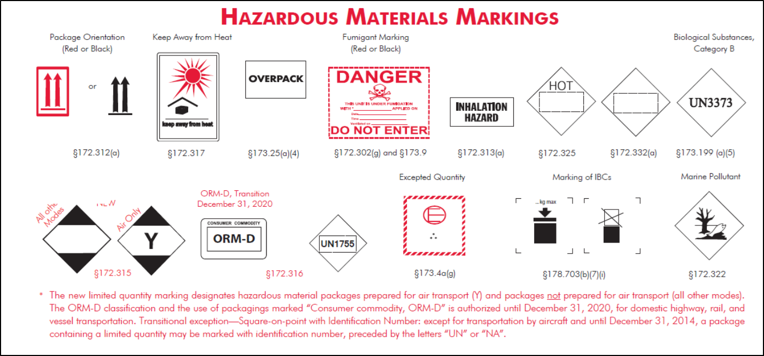
Hazard Communication Labels
DOT Markings
Source: DOT - PHMSA
Notes:
Source: DOT Chart 15, Hazardous Materials Markings, Labeling and Placarding Guide (n.d.), U.S. Department of Transportation, Pipeline and Hazardous Materials Safety Administration, PHH50-0138-0413, https://www.fmcsa.dot.gov/sites/fmcsa.dot.gov/files/docs/Hazardous_Materials_Markings_Labeling_and_Placarding_Guide_508CLN.pdf
49 CFR 172 Subpart D
“§172.300 Applicability.
(a) Each person who offers a hazardous material for transportation shall mark each package, freight container, and transport vehicle containing the hazardous material in the manner required by this subpart.”
Source: How to Comply with Federal Hazardous Materials Regulations (n.d., Federal Motor Carrier Safety Administration. https://www.fmcsa.dot.gov/regulations/hazardous-materials/how-comply-federal-hazardous-materials-regulations
“The requirements for marking of packages are contained in 49 CFR, Subpart D, Part 172. The basic marking requirement consists of the proper shipping name and identification number of the hazardous materials contained in the package. Markings should be durable, in English, and not obscured by other markings or labels. Depending on the material there may be additional marking requirements.”

Slide 42
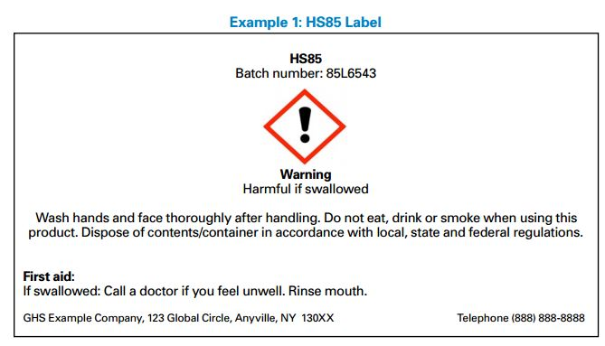
Locating Information
Source: OSHA
Notes:
Have students locate the following information on this sample label:
Signal word = Warning
Product identifier = HS85, Batch number: 85L6543
Hazard statement = Harmful if swallowed
Precautionary statements for prevention = Wash hands and face after handling. Do not eat, drink or smoke when using this product.
Precautionary statements for response = First aid: If swallowed call a doctor if you feel unwell. Rinse mouth.
Precautionary statements for disposal = Dispose of contents/container in accordance with local, state and federal regulations.

Slide 43
Locating Information
Source: OSHA
Notes:
Have students locate the following information on this sample label:
Pictograms =
Flame (used for flammables, pyrophorics, self-heating, emits flammable gas, self-reactives, and organic peroxide hazards)
Health hazard (used for carcinogen, mutagenicity, reproductive toxicity, respiratory sensitizer, target organ toxicity, and aspiration toxicity hazards)
Exclamation mark (used for irritants, skin sensitizer, acute toxicity, narcotic effects, respiratory tract irritant, and hazardous to ozone layer hazards)
Product identifier = NOMIXUP 7042012
Company = XYZ Chemical Company

Slide 44
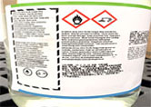
Locating Information
Source: OSHA
Notes:
Have students locate the following information on this sample label:
Pictograms =
Flame over circle (used for oxidizer hazards)
Corrosion (used for skin corrosion burns, eye damage, and corrosive to metals hazards)

Slide 45
Locating Information
In which section of an SDS would you find the following information:
Hazard identification such as hazard classification, signal word, and precautionary statements
Initial care instructions for untrained responders attending to an individual who has been exposed to the chemical
Recommendations for PPE
Section 2: Hazard(s) Identification
Section 4: First-Aid Measures
Section 8: Exposure Controls/Personal Protection
Notes:
Note: answers will appear with each click of mouse.

Slide 46
Summary
In this module we discussed:
Employer’s responsibilities under HCS
Components of a Hazard Communication Program
Requirements of different types of Hazard Communication labels
How to locate pertinent information

Slide 47
Knowledge Check
A hazard communication program requires which of the following components?
  Written program
  SDS/Labeling
  Training
  All of the Above
Answer: d. All of the above

Slide 48
Knowledge Check
2. How many sections are required on an SDS?
  11 sections
  16 sections
  4 sections
  As many as necessary to convey understanding
Answer: b. 16 sections

Slide 49
Knowledge Check
3. Which of the following statements is true of the
pictograms on HCS labels?
  Pictograms on HCS labels are identical to those used on DOT transport labels and may have various background colors.
  Consist of four bars that are color-coded as blue, red, yellow, and white to match hazard.
  HCS pictograms are required and standardized red square-on-points with black hazard symbols and white backgrounds.
  All of the Above
Answer: c. HCS pictograms are required and standardized red square-on-points with black hazard symbols and white backgrounds.

Slide 50
Knowledge Check
4. Your right to understand is _____.
  not simply shown or told
  not simply given an SDS
  required at initial assignment/when thing change
  all of the above
Answer: d. all of the above

